Slide 1
Visible Korean Human dataset
By Krupa Bhayani and Pronoma Banerjee

Slide 2
Introduction
The Visible Korean Human project was started in 2001 at Ajou University, Suwon, Republic of Korea and was the second experiment that compiled data from magnetic resonance imaging (MRI), computed tomography (CT) and comprehensive anatomic images of a male cadaver; the other similar projects being the Visible Human Project (1994-1995) and Chinese Visible Human Project (2002-2003). This was the first successful attempt at producing colour anatomic images of a human body. The study also produced segmented images of 11 structures derived from the anatomic images.

Slide 3
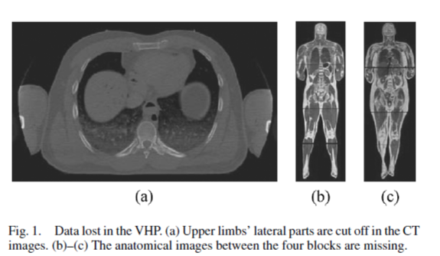
Drawbacks of Visible Human Project
The anatomical images of the VHP data did not include anatomical structures that were smaller than 0.2 mm since both the interval and pixel size of the images were 0.33 mm or greater.
.

Slide 4
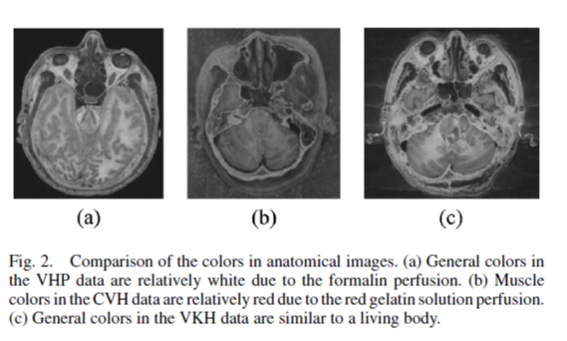
The color of the anatomical images of the VHP data were not similar to a living body because formalin was perfused into the cadaver prior to serial sectioning.
The VHP did not publish the segmented images, which are essential to produce 3D images of each anatomical organ.

Slide 5
Experiment

Slide 6
Specimen
33 year old male cadaver
An average male Korean body habitus
Length: 1.718m (feet plantarflexed)
Weight: 55kg
Cause of death: Leukemia
Cadaver was placed supine into an immobilization box. Position was fixed with an immobilizing agent (Mev-Green)

Slide 7
MR Scans
Slice thickness: 1mm, Interslice gap: 0mm
Field of view: 480mm x 480mm
Resolution: 512 x 512
Repetition time (TR): 800ms, Echo time (TE): 8 ms, NEX: 2
Interleave method
MR images were downloaded and saved as tag image file format (TIFF) files (bit depth: 8 bits, greyscale).
2 series of MR images (head to knee and knee to toe) were combined and aligned.

Slide 8
CT Scans
Slice thickness: 1mm
Interslice gap: 0mm
Field of view: 480mm x 480mm
Resolution: 512 x 512
Standard algorithm
Voltage: 120kV
Electric current time: 280 mAs
CT images were also saved as TIFF files (bit depth: 8 bits, greyscale).

Slide 9
Cryosectioning
Cadaver was transferred to an embedding box in its original direction.
4 alignment rods were inserted into the embedding box.
Small quantities of embedding agent were poured and the box was frozen in steps, until box was completely filled.
Frozen box was placed longitudinally on the cryomacrotome, which was then moved through the rotating cutting blade to produce serially sectioned images of thickness 0.2mm.
The sectioned surfaces were positioned beneath a mounted digital camera (DSC560, Kodak; resolution: 3,040 x 2,008; bit depth, 24 bits color) and digitally captured with both color and gray scale.
A total of 8,590 anatomic images were downloaded and saved as TIFF files.

Slide 10
Segmentation
Eleven important structures (skin, bones, liver, lungs, kidneys, urinary bladder, digestive tract, respiratory tract, arteries, brain, and heart) from the anatomic images were selected to be segmented.
Contours of the anatomic structures were semi-automatically drawn using the magnetic lasso tool of Adobe Photoshop.
Each structure was colored to produce 8,590 segmented images.
The anatomical and segmented images were stacked and volume-reconstructed to produce 3-D images.

Slide 11
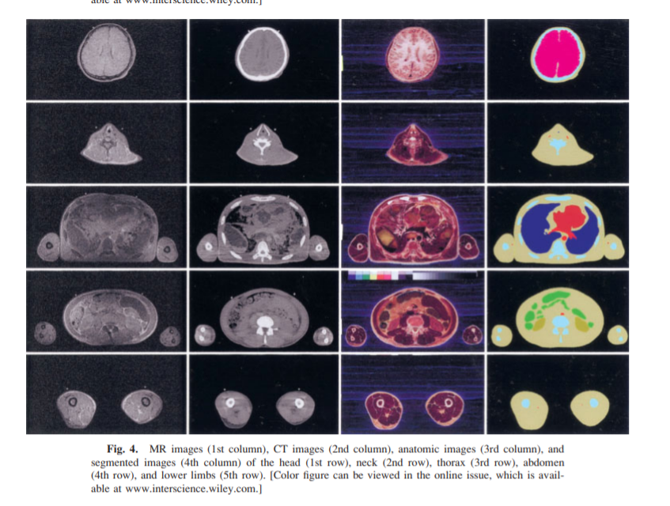

Slide 12
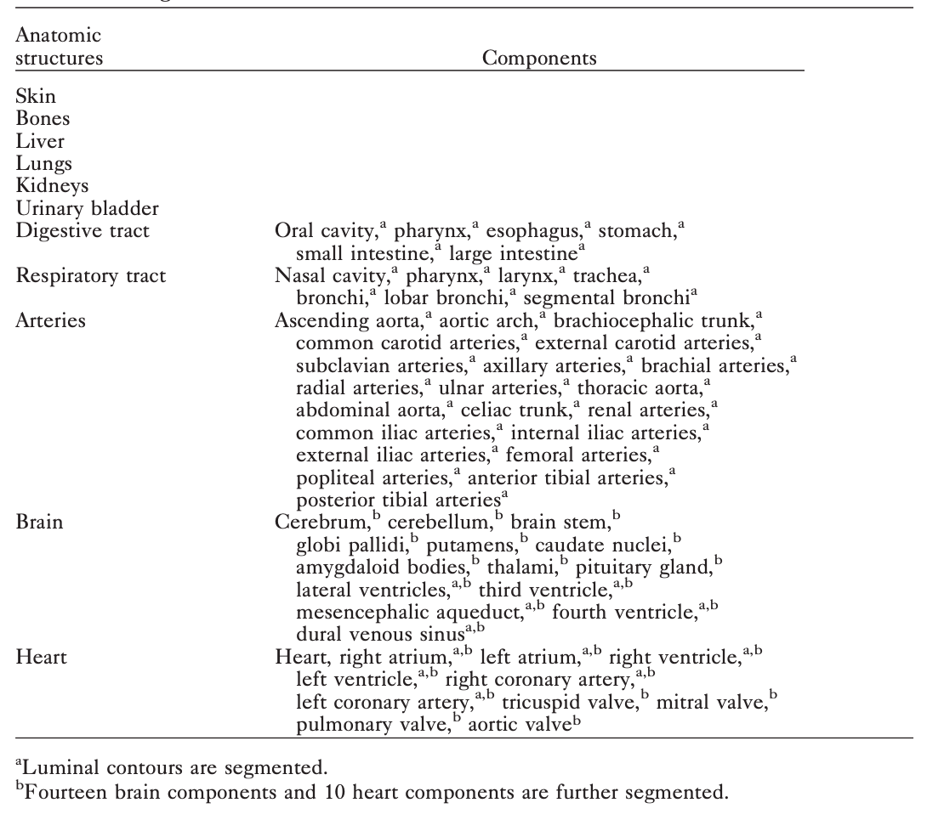
Segmented Anatomic Structures ⁽¹⁾

Slide 13
Segmentation
All 8590 anatomical images (3040 x 2008 pixels) were stacked at 0.2-mm intervals and subsequently volume-reconstructed to produce a 3-D image, which consisted of 3040 x 2008 x 8590 voxels. The segmented images were made into a 3-D image in a likewise manner.

Slide 14
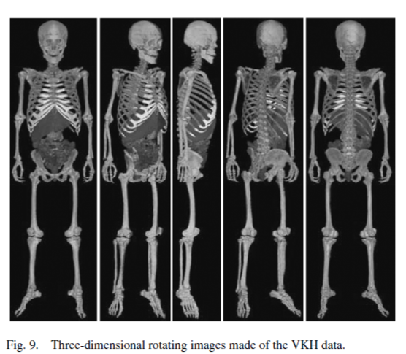
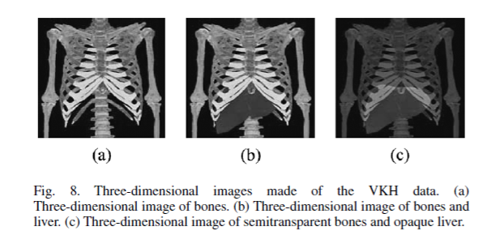
Anatomical structures are clearly visible in 3 D images produced by VKH data.

Slide 15
Results

Slide 16
Full-sized data
Intervals of the MR and CT images were 1mm, producing 1718 pairs of MR and CT images. Each cropped MR and CT image had resolution: 505 x 276, pixel size: 1mm, 8 bits gray, and file size: 147 kB.
Intervals of the anatomic images were 0.2mm, resulting in 8590 pairs of anatomic and segmented images.
Each anatomic image had resolution 3040 x 2008, 24 bits colour and file size: 17890 kB.
Each segmented image had resolution 3040 x 2008, 8 bits colour and file size: 5900 kB.
File size of full-sized data was 197.5 GB in total

Slide 17
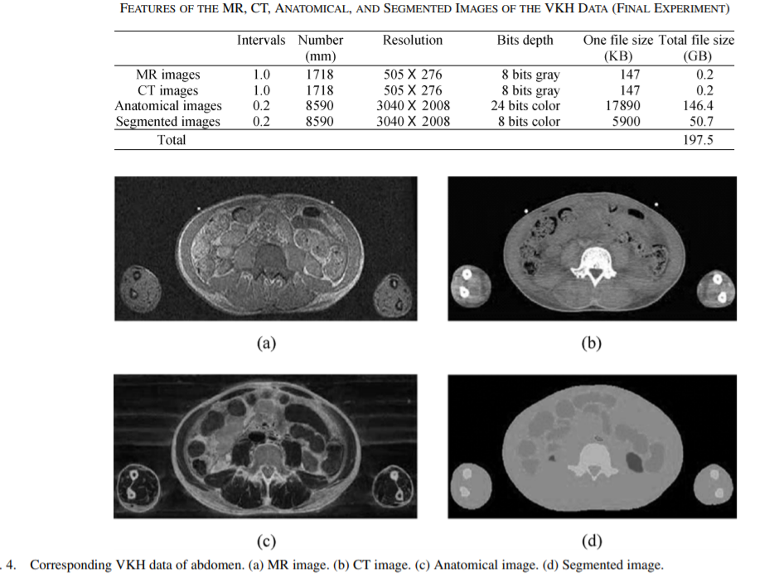

Slide 18
Alignment
The first CT image series, from head to knee, and the second CT image series, from knee to toe, were scanned separately, then combined and aligned as the same procedure of MR scanning.
The anatomic images were aligned, which was verified using the alignment rods as a frame of reference.
Every MR and CT image (1.0 mm intervals) corresponded to every fifth anatomic image (0.2 mm intervals).

Slide 19
Further details on the data
The MR and CT images revealed relatively distinct anatomic structures, which were consistent throughout the entire cadaver.
The anatomic images displayed consistent brightness. The images showed distinct anatomic structures with realistic colors.
The contours of the 11 segmented anatomic structures were accurate as compared to the serially segmented images.

Slide 20
Reduced data ⁽¹⁾
For ease of data use and storage, the file size of the VKH data was reduced from 197.5 GB to 1.8 GB by primarily decreasing the resolution of the anatomic and segmented images from 3040 x 2008 to 608 x 402.

Slide 21
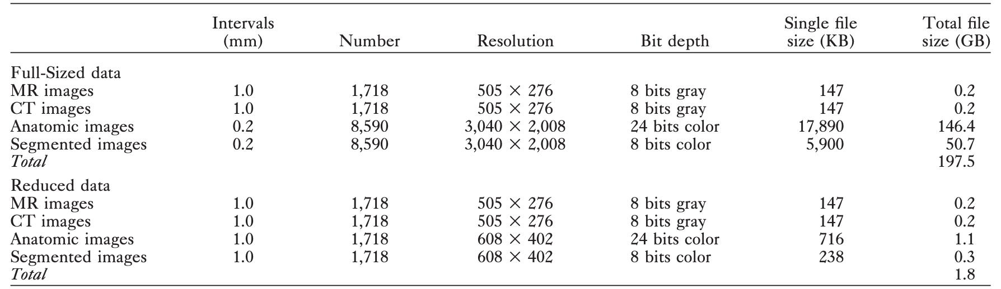
Table: MR, CT, Anatomic, and Segmented Images either as full-sized data or as reduced data ⁽¹⁾

Slide 22
References
Jin Seo Park, Min Suk Chung, Sung Bae Hwang, Byeong-Seok Shin, Hyung Seon Park, 2006, Visible Korean Human: Its Techniques and Applications. Clinical Anatomy 19:216–224.
Jin Seo Park, 2005, Visible Korean Human: improved serially sectioned images of the entire body. IEEE transactions on medical imaging 24.3: 352-360.

Slide 23
Thank you

